Slide 1

Qatar Public Schools PPP program – Package 2
Industry Briefing Session

Slide 2


The Qatar Schools PPP Project
Qatar has identified 47 schools to be implemented under a PPP framework. The 47 schools will be divided into 4 packages, each consisting of 8-14 schools.
Planned Deal Flow | RFP date | Expected Delivery date
Package 1: 8 schools (Under Procurement) | May 2019 | 2022
Package 2: 12 + 2* schools | March 2020 | 2023
Package 3: 14 schools | TBC | 2024
Package 4: 11 schools | TBC | 2025
*Package 2 will include 2 Science &Technology Colleges; to be added to the original project scope specified in the RFQ document. Further details around the Colleges will be circulated to prospective interested respondents.
The Project has been launched to help the State of Qatar meet its increasing demand for good quality educational facilities. This demand is in line with the government’s vision 2030 and Qatar Second National Development Strategy 2018-2022.

Slide 3






Project Scope
School Type
Gender
Location
Approx. Site Area (Sq.m)
No. of Students
No. of Staff
1
Preparatory
Girls
Muaither, Al Rayyan
24,868
750
90
2
Secondary
Boys
South Wajbah, Al Rayyan
28,916
750
90
3
Preparatory
Boys
Gharafa, Al Rayyan
19,411
750
90
4
Primary
Boys
Ain Khalid, Al Rayyan
39,215
750
90
5
Primary
Girls
Muaither, Al Rayyan
28,934
750
90
6
Primary
Boys
Al Waab/Sudan, Al Rayyan
14,219
750
90
7
Preparatory
Girls
Al Thumama
26,679
750
90
8
Typical
Boys
Al Aziziya, Al Rayyan
16,564
750
90
9
Primary
Girls
Al Wukair, Al Wakra
25,684
750
90
10
Shared
Boys
Rawdet Rashid, Al Sheehaniya
32,100
750
90
11
Primary
Boys
Al Thumama
25,835
750
90
12
Secondary
Girls
Al Thumama
27,752
750
90
13
Science &Technology
Boys
Jeryan Jenaihat
35,000
640
TBD
14
Science &Technology
Girls
Jeryan Jenaihat
25,000
440
TBD
Vacant Plots (9)
Demolition Needed (5)

Slide 4
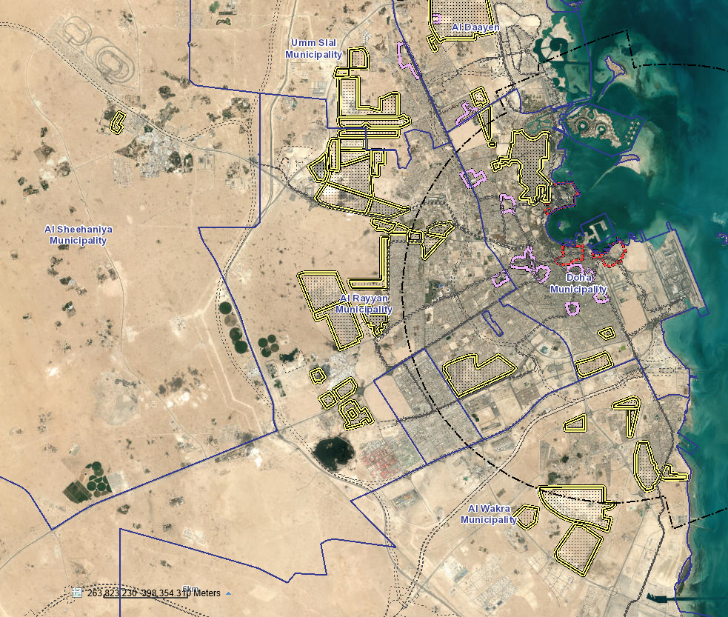
Site Locations – 14 Sites
Vacant land (9No.)
Site 13 & 14
Evacuated schools (5No.)
Doha Municipality: 3 schools
Al Daayen Municipality: 2 schools
Al Rayyan Municipality: 7 schools
Al Wakra Municipality: 1 school
Al Sheehaniya Municipality: 1 school
Site 8
Site 3
Site 6
Site 5
Site 2
Site 12
Site 10
Site 1
Site 4
Site 7
Site 11
Site 9

Slide 5
Roles and Responsibilities

Slide 6




The Private Sector is responsible for the Design, Build, Finance, Operate, Maintain and Transfer (DBFOMT)
Design
Designing the schools in accordance with requirements and output specification
Build
Building the schools in accordance with requirements and output specifications
Finance
Financing the project by identifying a clear funding solution
Operate
Operating the schools in accordance with the Project Company’s responsibilities
Maintain
Providing maintenance in accordance with the Project Company’s responsibilities
Transfer
Transferring the schools back to the Authority at the end of the concession period

Slide 7

The Government’s role and involvement in the Project
In the Schools project:
MoEHE will be responsible for teaching and school administrative activities.
Ashghal will be the Authorised Representative during the procurement process.
All payments will be on a performance and availability basis.
Demand risk for the schools will not be transferred to the Private sector PPP provider.
The private investor bids competitively for the right to Design, Build, Finance, Operate, Maintain and Transfer the 14 schools
Government
Private Sector
Design
Build
Finance
Operate
Maintain
Transfer
The advantages of this mechanism is to:
Minimise management complexity by limiting Government interactions to one investor.
Reduce procurement efforts by requiring a unique contract with a private sector investor.
Consumers

Slide 8
The Project Company must be able to deliver on all aspects of the Project (1/2)
The project will be DBFOMT project and consequently the Project Company must have:
Ministry of Education and Higher Education
The ability to design, build and maintain a school, through a joined up solution across all project stages.
Design, Build, Operate, Maintain and Transfer 14 Schools
Provision of land on to build the schools and operate during the contract
Payment based on availability and performance of schools
A reputed partner that has design, build and maintenance capabilities or else must bring in a subcontractor that has international and regional experience in developing and managing similar education or real estate projects.
Equity
Project Company
Debt Financing
Lenders
Shareholders
Dividends
Debt Service
The provision of fully integrated service delivery. E.g. FM provider involvement in the Design process to ensure deliverability and proper risk mitigation.
Construction Payments
Service Payments
Design Construction / EPC Contractor
FM Contractors

Slide 9
The Project Company must be able to deliver on all aspects of the Project (2/2)
The Project Company must also be able to demonstrate their ability to inject equity and raise finance.
Ministry of Education and Higher Education
The Project Company will have flexibility to raise debt locally, internationally or through ECA loans as well as decide on the loan term.
Provision of land on to build the schools and operate during the contract
Payment based on availability and performance of schools
Design, Build, Operate, Maintain and Transfer 14 Schools
At the RFP stage bidders shall provide firm evidence of support from equity and debt providers towards providing financing for this Project.
Equity
Project Company
Debt Financing
Lenders
Shareholders
Dividends
Debt Service
Construction Payments
Service Payments
Design Construction / EPC Contractor
FM Contractors

Slide 10
The Project Company’s role in Operation and Maintenance
Service
Definition
Is the Project Company Responsible?
Facilities Management
Provision of routine maintenance (caretaking and site supervision, management services, security management services etc.).
Provision of major maintenance (buildings, installations and asset management services; grounds maintenance services etc.).
Other FM (fixtures and fittings, waste management, pest control etc.).
Provision of utilities (note: utility consumption will be born by the Authority).
✔
Catering
Provision of food for school children and teachers.
✗
Security
Provision of security personnel for all facilities and all security cameras, control panels and supporting infrastructure etc.
✔
Furniture Provision
Provision of fixed furniture.
Provision of loose furniture as a one time responsibility based on approved vendors.
Maintenance of fixed furniture.
✔
Maintenance of loose furniture.
✗
ICT
Provision
Provision of the necessary infrastructure needed (wiring, fiber optics etc.)
✔
Procurement and maintenance of loose IT equipment.
✗

Slide 11
Project works are expected to commence in the start of 2021
March 2020:
Issue of RfP to Pre-qualified Bidders and Proposal Presentation
October 2020: Selection of Preferred Bidder
Evaluation of the Proposals
Works Commence Q1 2021
Request for Qualification
Request for Proposal
Commercial Close
Financial Close
Works End June 2023
January 2020:
Issue of RfQ
August 2020:
Submission of Proposals
January 2021:
Financial Close

Slide 12
Evaluation of the RfQ

Slide 13
RfQ Evaluation Methodology
Stage 1: A review of the Statements of Qualifications (SoQs) to check if Respondents meet the minimum threshold requirements
Legal compliance
Minimum thresholds
Respondents must ensure legal compliance by providing all required legal documents (declaration forms, confidentiality agreements, etc.).
Respondents must also meet the minimum pass/fail thresholds of Stage 1.
Stage 2: A detailed review of the quality of the SOQs against the evaluation criteria

Slide 14
Stage 1 Evaluation: Pass/Fail criteria
No. | Criteria | Minimum Threshold to be Considered for RfQ Evaluation | Applicable to:
1 | Legal | The Respondent has provided a signed Declaration. | Respondent or each Consortium member
2 | Financial Strength of the Respondent | The Consortium should have an average minimum tangible net worth of USD 50 m (or equivalent) in the past three years. | Respondent or Consortium
3 | Experience and Track Record in Raising Finance | The Respondent should have experience in project finance for at least one education/real estate project in the last 5 years. | Respondent or Consortium
4 | PPP Experience | The Respondent should have carried out at least one project with a PPP type structure in the last 5 years. | Respondent or Consortium
5 | Design Experience | The Respondent should have experience in designing at least one building (education, health, or real estate) with a minimum GFA of 10,000 sqm in the last 5 years. | Respondent or Consortium
6 | Construction Experience | The Respondent should have experience in constructing at least one building (education, health, or real estate) with a minimum GFA of 15,000 sqm in the last 5 years. | Respondent or Consortium
7 | Facilities Management | The Respondent should have experience of FM for at least one building (education, health, or real estate) with a minimum GFA of 15,000 sqm in the last 5 years. | Respondent or Consortium
8 | Regional Experience | The Respondent should have construction or facilities management experience for at least one similar project within the region in the last 5 years (refer to defined term “Regional Experience”). | Respondent or Consortium

Slide 15
Stage 2 Evaluation: Overall Scoring Weights on the Statement of Qualification
Consortium Profile*
Financial and Market Standing
Technical
Respondents need to score at least 70% (qualifying score) to be considered for RfP Stage
20%
1
30%
2
50%
3
*Evaluation criteria includes but not limited to: clear allocation or roles and responsibilities, risk management, and previous experience of consortium members working together.

Slide 16
Stage 2 Evaluation: Financial and Market Sounding Evaluation and Scoring
The financial and market sounding evaluation is worth
30%
Respondent and each Consortium Member’s financial strength to undertake a long-term Project of this nature
Respondent and each Consortium Member’s experience and track record in raising limited recourse finance for projects of similar nature and complexity
15%
1
15%
2

Slide 17
Technical Considerations

Slide 18
Technical Submission Requirements
Candidates will be pre-qualified based on their technical experience and capability to undertake the Project:
Design Experience
Experience with the Government of Qatar
Risk Management Approach and Experience
Facilities Management Experience
PPP Experience
Construction Experience
1
2
Required Technical Qualifications
3
4
5
6

Slide 19
Stage 2 Evaluation: Technical Evaluation and Scoring
Relevant experience in PPP Projects regionally and internationally*
Relevant experience in facilities management of schools
Availability of resources with sufficient technical capability
Relevant experience in design or design management of schools
Relevant experience in construction or construction management of schools
10%
1
The technical evaluation is worth
50%
10%
2
10%
3
10%
4
10%
5
*PPP experience includes evidence of the Respondent’s ability to undertake an integrated non traditional approach to project financing and commissioning of similar project (i.e. not just EPC contracting).
Qualifying experience would include previous projects where the Respondent undertook the Design, Build and Operate (DBO) of similar projects or other forms of integrated delivery models. We encourage interested Respondents to provide sufficient relevant qualifying experience as only the information provided in the SOQ will be evaluated.

Slide 20
What we expect from Bidders now in order to achieve compliant and quality submissions during the RFP stage
Learnings, based on our assessment of previous bid submissions, to help you achieve quality and compliant proposals at later stage:
It is expected that Bidders approach and identify relevant Grade A Designer, Building and FM Contractors during the RFQ stage in order to provide the Authority with credible evidence of their ability to meet all project requirements.
There will be a strict requirement for pre qualified Bidders to submit signed Building and FM term sheets as part of their bid submissions (RFP stage).
The Designer, Building and FM Contractors can only be replaced during the RFP stage by obtaining a non-objection from the Authority and/or PWA.
Bidders will be strictly required to provide completed financial term sheets with the financial proposal. It is advisable that Bidders approach lenders early in the RFP process.
Identifying Building and FM Contractors, and approaching lenders, during the RFQ stage minimises perceived project delivery risks
As part of the bid submissions during the RFP stage:
Signed Building and FM Contractors Term Sheets will be strictly required
Integrated service delivery solution, such as FM involvement in Design must be demonstrated
Bidders are required to meet all legal, technical and financial compliance requirements
It is therefore imperative that prospective Bidders consider these requirements during the RFQ stage and not defer any of the legal, financial and technical compliance requirements

Slide 21
Expected RfP Submission Requirements
Financial Requirements
Technical Requirements
The RFP documents will provide technical and output specifications and, draft Project Agreement and other documents to enable pre-qualified bidders prepare their responses
Quality Plans
O&M Plans
Team Experience
Authority and Stakeholder Management
Programme Management
Design Management
Building Works
Funding Strategy
Detailed negotiated term sheets
Previous experience in sourcing financing
Financing Plan and Financial Structure
Financial Model
Financial Form Sheets
Building Works

Slide 22
Legal Considerations

Slide 23
Legal Considerations
Legal Framework
Procurement Oversight
Contracting Method
The procurement process is government by the Tenders Law (Law No. 24 of 2015) and it’s implementing Executive Regulations (Cabinet Decision No. 16 of 2019)
The Grand Tenders Committee (GTC) will manage the procurement process for Ashghal which in turn is conducting the procurement on behalf of MOEHE
Public tender conducted in accordance with Book 2, Chapter 1 (Public Tender) of the Executive Regulations

Slide 24
Contractual Framework
Key Agreements with MoEHE
Other Agreements and Documents
The PPP Agreement
Key Terms
A draft of the PPP Agreement, which will govern the contractual relationship between MoEHE and the Project Company for the Project
Other agreements will include site leases, on-street licensing and a substitution agreement governing lenders’ relationship with MoEHE
Prior to closing the PPP Agreement, the Project Company will need to deliver its project and financing documents, including EPC Contracts, O&M Contracts, any other subcontracts, senior and subordinated financing documents, collateral warranties and insurance policies
Structured in accordance with regional, particularly recent Qatari PPP documentation and international precedent
Technical output specifications to be attached as schedules
Defines financial matters, including substitution agreement, collateral warranties and securities
Include without limitation compensation events, relief events, force majeure events, change in law, indemnities, insurance requirements, early termination and termination payments, refinancing and dispute resolution

Slide 25
Q&A

Slide 26
Thank you
Q&A

